Slide 1
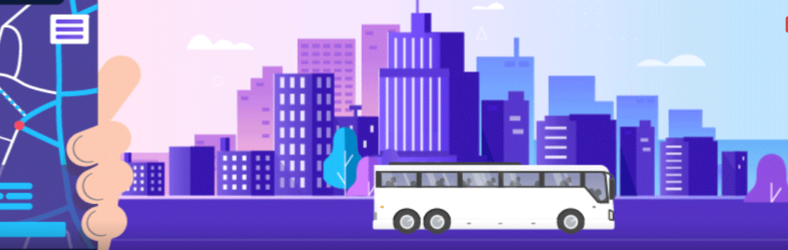

NEC HACKATHON: TRANSPORT

Slide 2


TEAM NAME: NEXT TECH PROJECT NAME: H P IN Team MEMBERS: Rishabh SHARMA, ARYAN PANDEY, DEVANSH SWARUP, PRASHANT GUPTA

Slide 3
H p in
An end to end travel solution
Theme
Transformation of public transport by using web or service applications to elevate user motivation.

Slide 4



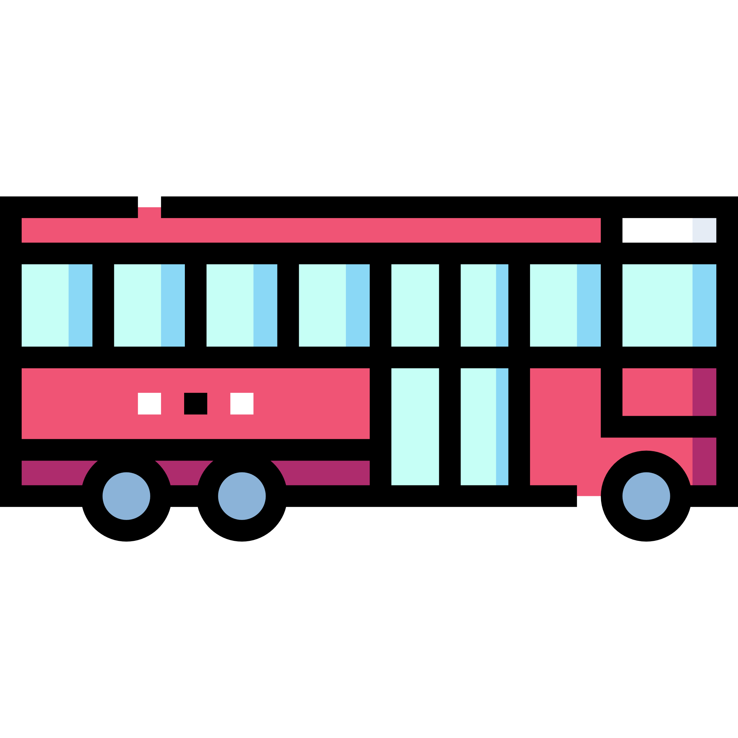


Problem and Solution
1
Problem
Over crowding and crowd density
Due to a very high population in the country the modes of public transport face a very severe and undistributed population load, thus leading to bad services and reputation
Solution
Real time analysis and GPS
Real time analysis of passengers, through computer vision& AI camera which are pre-installed in the bus due to GOVT norms thus providing details of current availability of seats for the next set of passengers. We propose to install infrared strips on bus for better results
Live tracking through GPS, allowing transparency and real time tracking/time analysis, thus helping the user to make educated decision of what type of transport to use

Slide 5


Problem and Solution
2
Problem
Payment/Monetary problems
Untraceable forms of payments like cash prevents the enterprise from generating revenue due to bribery and other such malpractices, moreover other forms of payments like metro/bus cards require constant recharge, which provides another hinderance in smooth functioning
Solution
Wireless Payments
Implementation of NFC based payments by simple touch and go mechanism providing smooth functioning without carrying any other form of payment cards, thus promoting smooth and swift functioning.

Slide 6

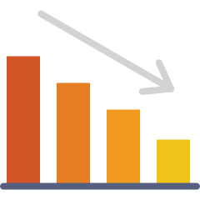
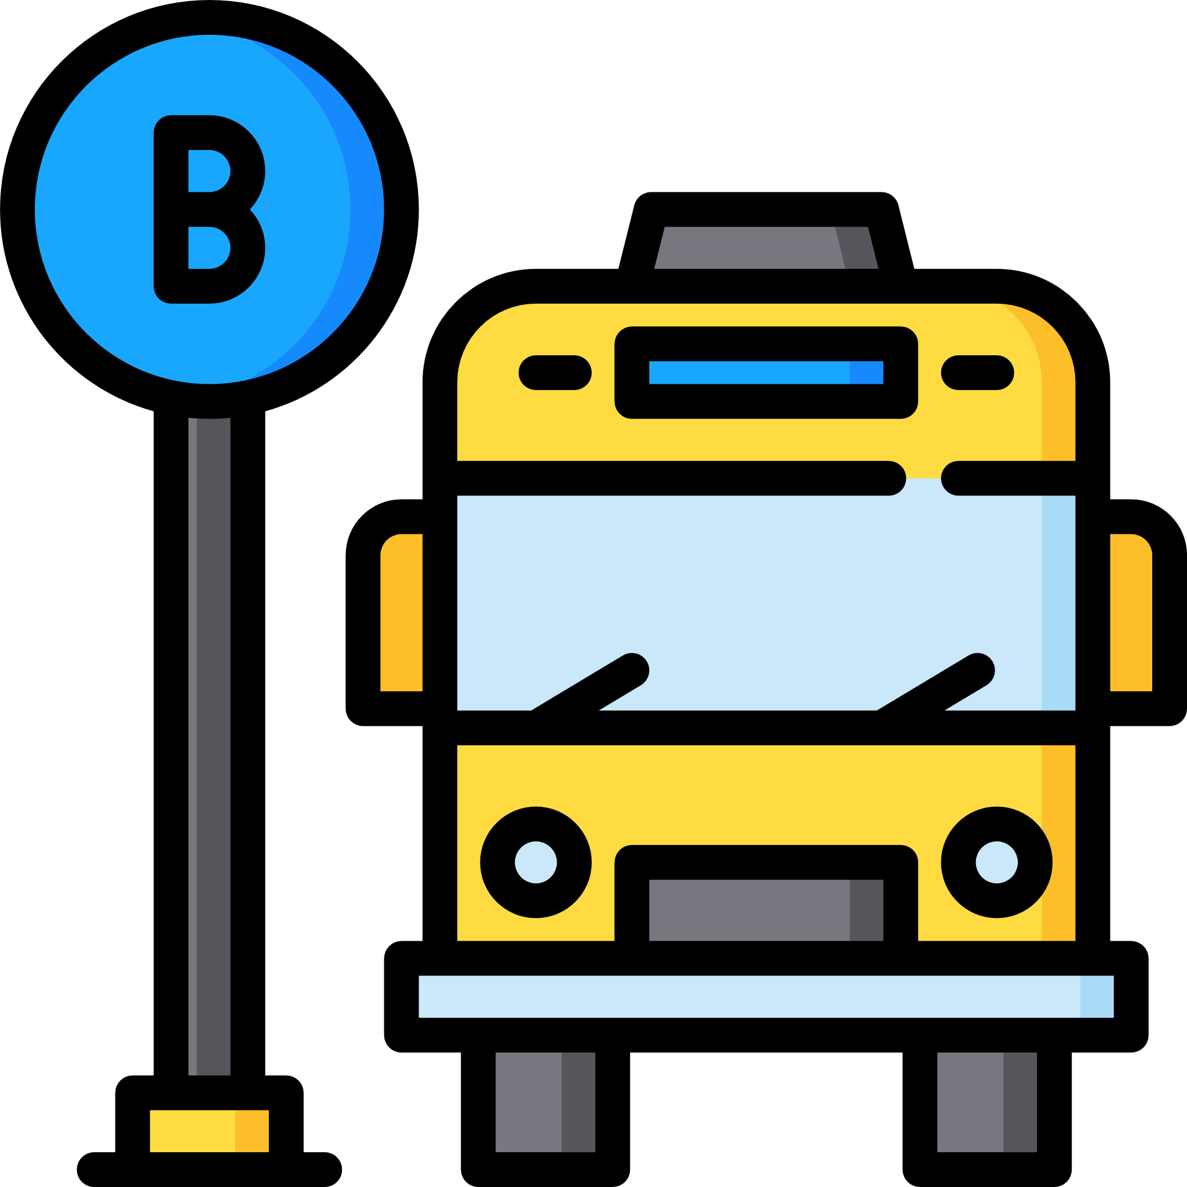

Problem and Solution
3
Problem
Inefficient boarding mechanism
Due to lack of data, vehicles tend to travel in a conventional path defined mechanism, which often leads to inefficiency and loss of valuable customer, thus revenue.
Solution
Implementing a jumping/bouncing path using BDA
The platform uses BDA to provide an unconventional approach thus providing a new route in every cycle to enhance productivity, save time and increase revenue flow

Slide 7





Problem and Solution
4
Problem
Lack of synchronised transport
As in India people often need to switch modes of transport before they finally reach their final destination, this is due to lack of reach of big body transport options in the hyperlocal environment .
Solution
Synchronised transport mechanism by providing all form of transport under one platform
The platform brings all kind of transportation mechanism under one roof and provides synchronised booking during the journey, thus promoting easy flow in the journey without hinderance and saving time.

Slide 8




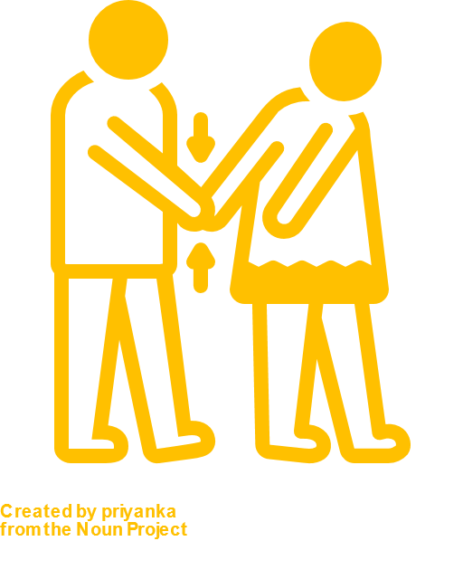
Problem and Solution
5
Problem
Safety issues
In India the basic public notion is inclined towards the side that public transport are not yet a safe mode of transport
Solution
Threat detection program
The platform offers a weapon detection program using AI and computer vision to provide information about illegal possession of arms in a public place thus promoting safety.

Slide 9


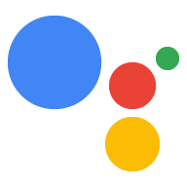
Tech Stack
React Native
(front End)
Mongo DB server
(Backend)
Frontend APIs
Google Maps
Node js
Actions of google

Slide 10




Dependencies
Availability of internet services
Banking system
must be available
Availability of Server
Wireless Payment NFC

Slide 11
Focused Sectors
Public Transport
Travel Companies
Banking
Contactless payment providers and internet companies

Slide 12
?
Any Questions

Slide 13
Thank You

